Slide 1
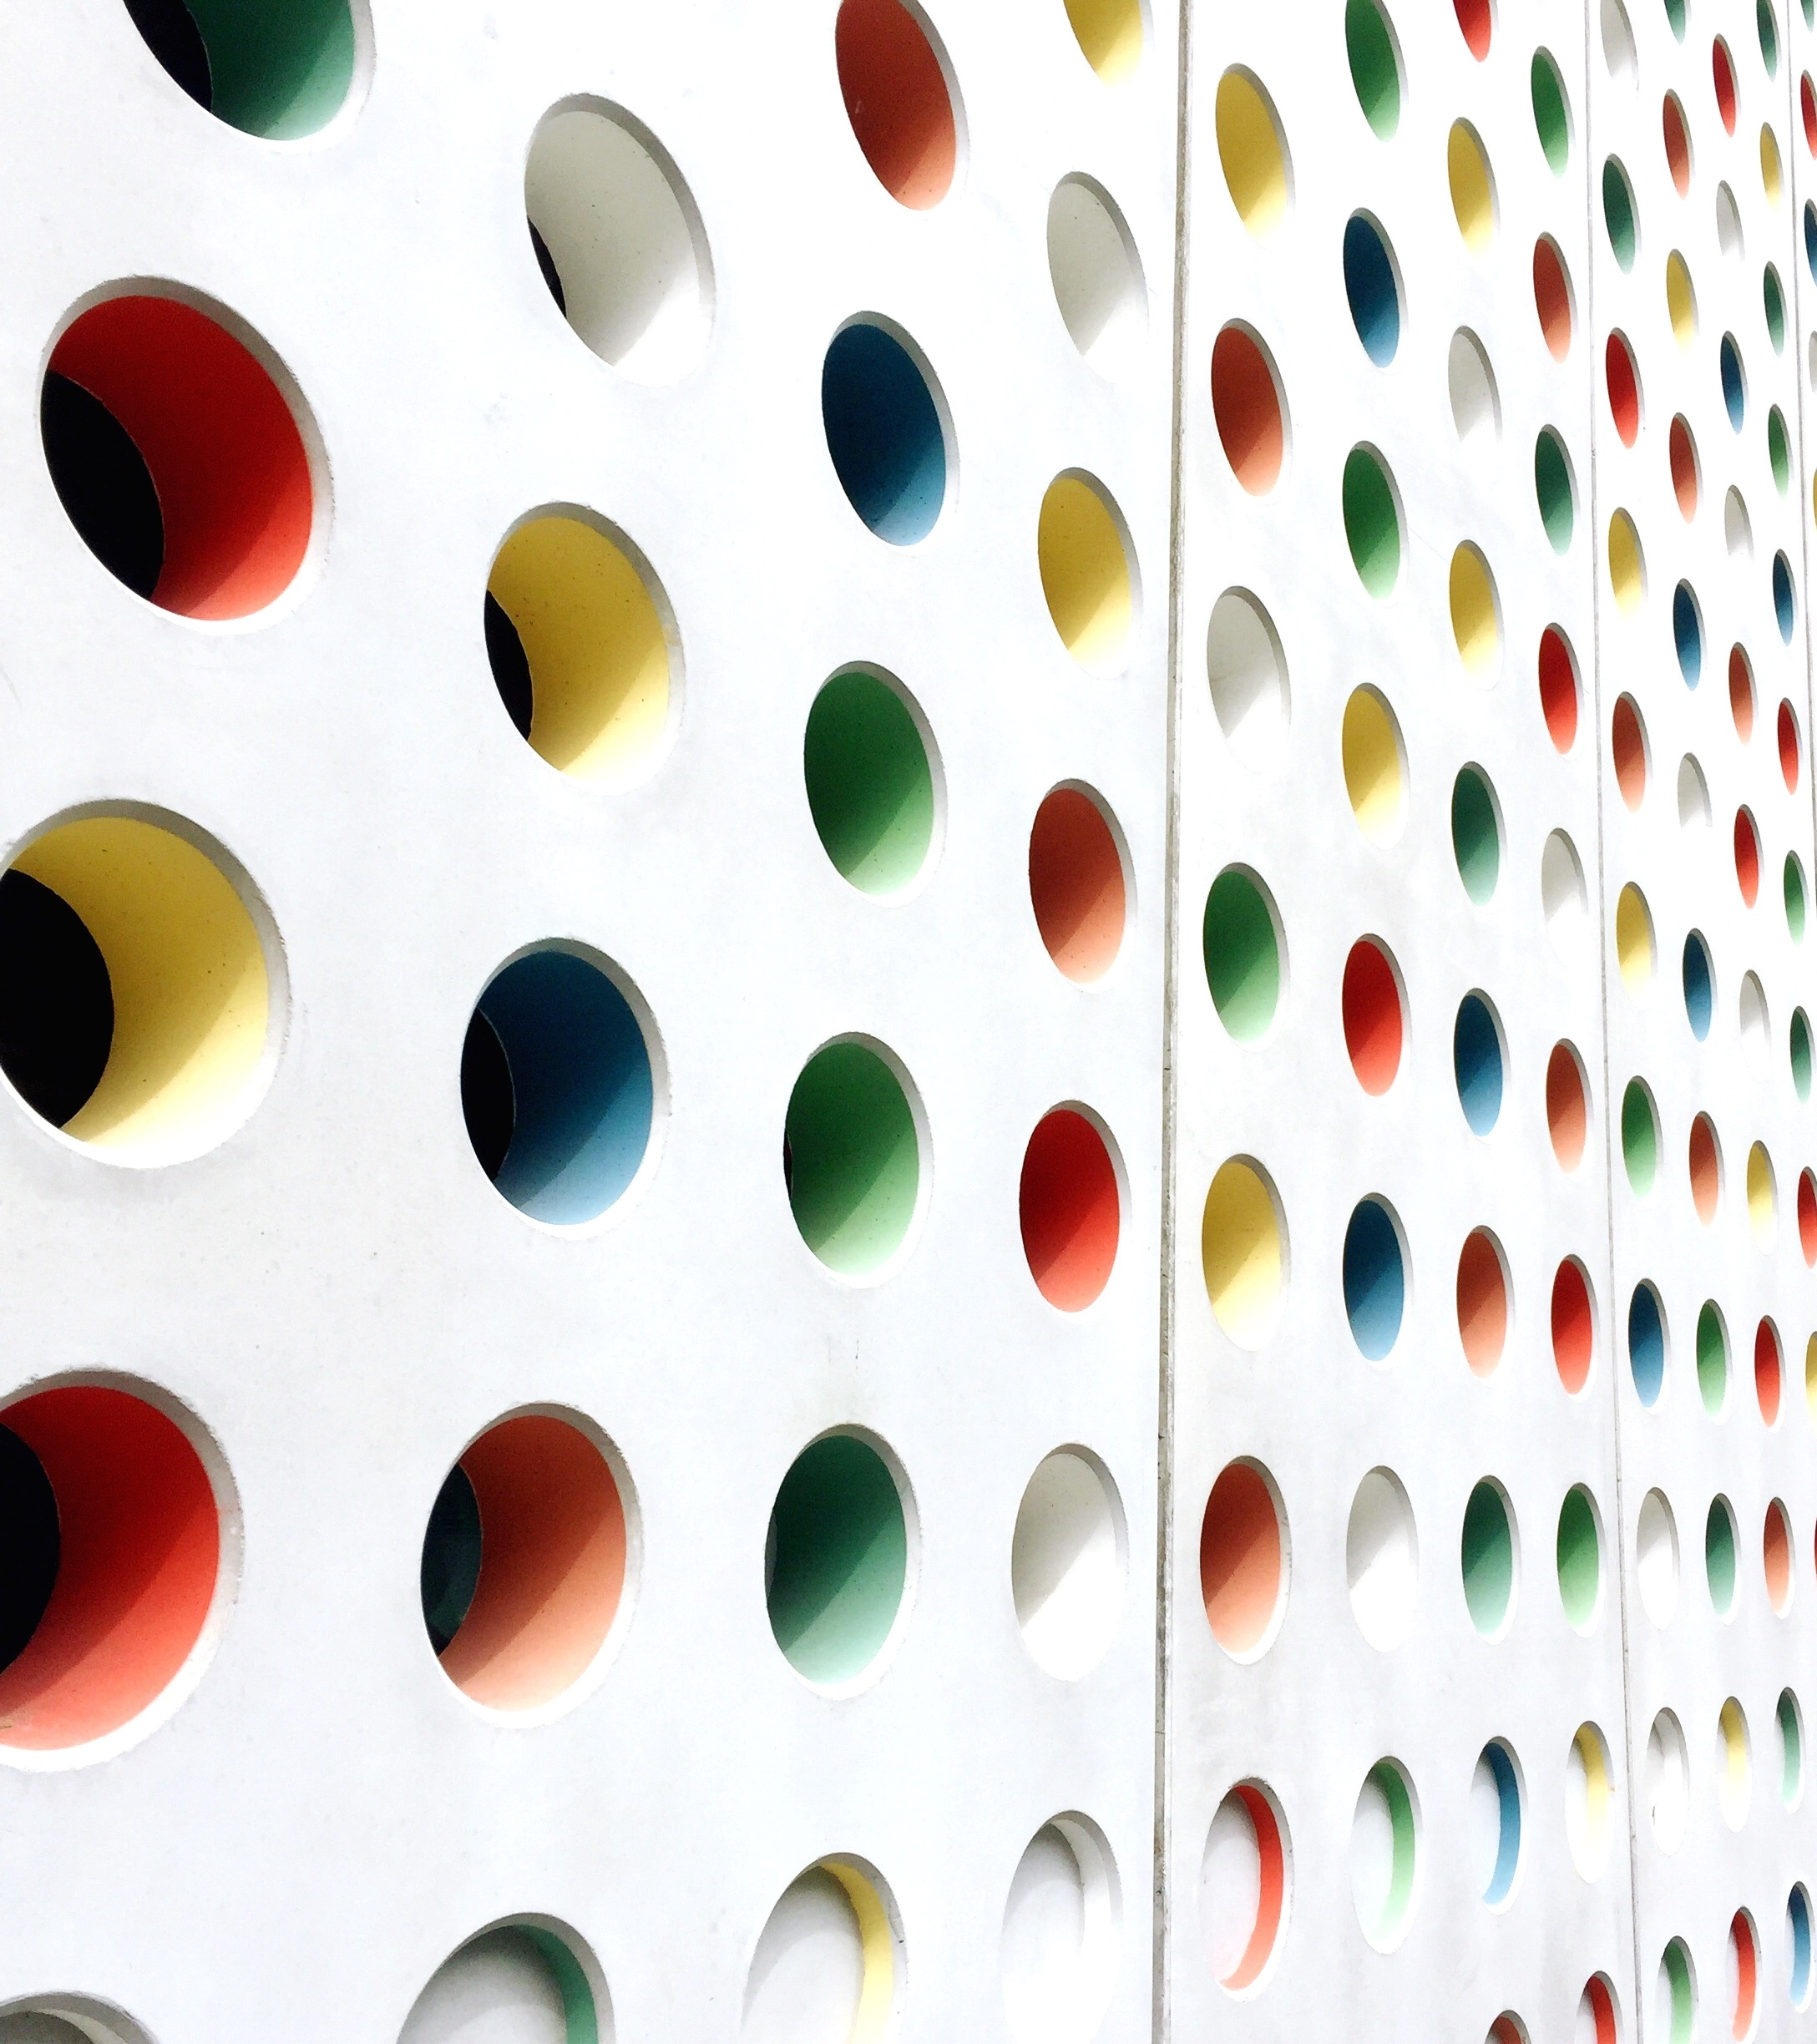
Hopfield Network Implementation
Tamir shoresh
Dan goren
Liora cohen

Slide 2

Agenda
Theoretical Reminder
EMNIST letter classification task
Benchmarks
Our Hopfield-based model
Implementation in Pytorch
Model Optimization & Results
Future Work

Slide 3
Reminder of Hopfield Networks
Simple Hopfield Network
associates some input vector with a pattern that has been previously saved in the network by minimizing an Energy Function.
Modern Hopfield Network
uses a more complex Energy Function (with an Interaction Function) in order to increase the memory capacity without increasing the size of the memory.
Continuous-Valued Hopfield Network
uses an Energy Function with an exponential Interaction Function and with a quadratic term that sets upper and lower boundaries on the Energy Function.

Slide 4
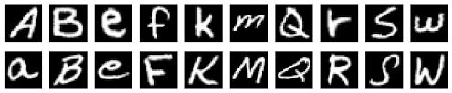
EMNIST Letters
This dataset contains 145,600 images of handwritten English Letters
The images are divided into26 balanced classes (26 letters) including both uppercase and lowercase letters.

Slide 5
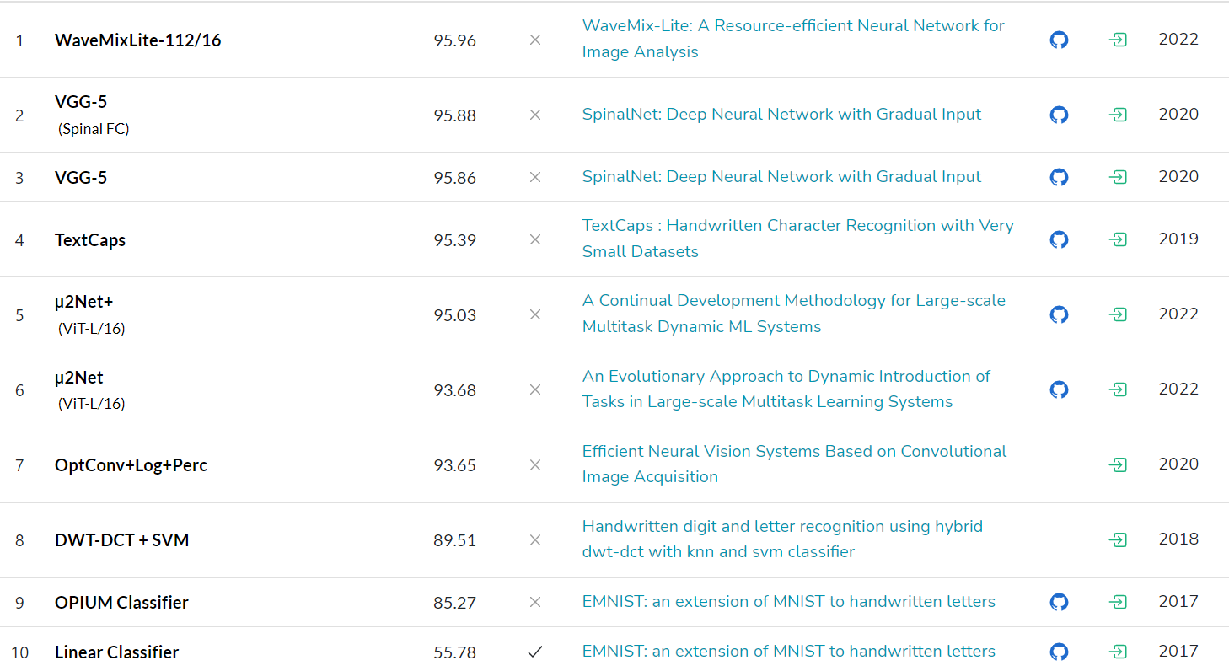

Slide 6
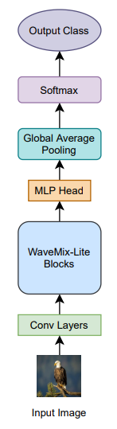
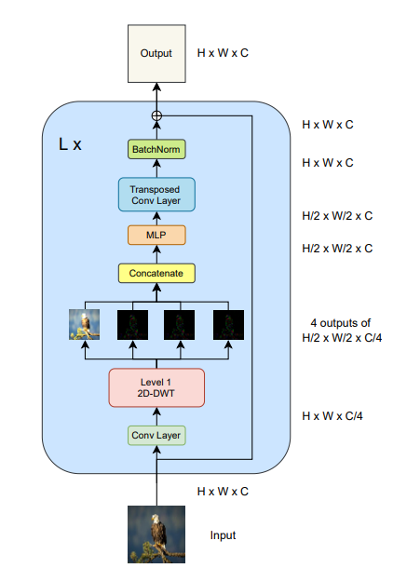
WaveMixLite-112/16
WaveMixLite uses 2D-discrete wavelet transforms to efficiently mix spatial information from pixels.
The trainable convolutions before the wavelet transform allow the extraction of only those feature maps that are suitable for the chosen wavelet family.

Slide 7
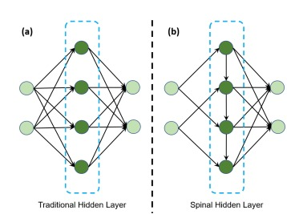
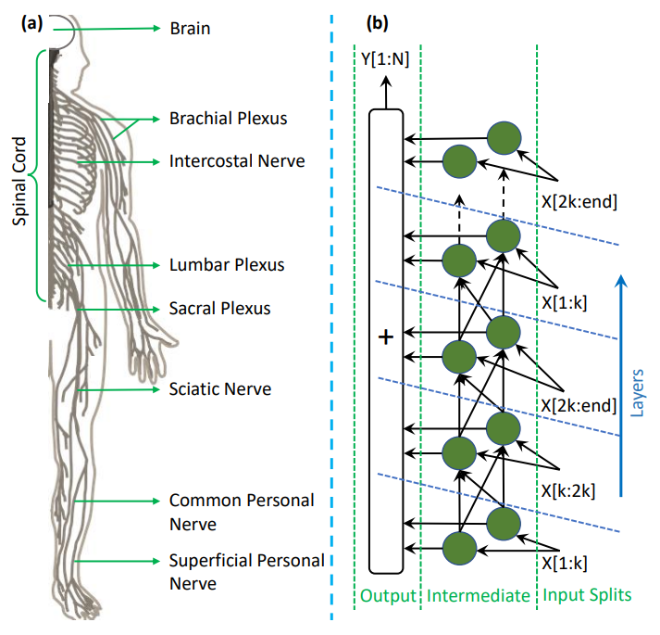
VGG-5 + SpinalNet
VGG-5 is a CNN with 5 conv. layers
SpinalNet mimics the way our nervous system works
This architecture incorporates SpinalNet as the Dense layers at the end of the VGG-5.

Slide 8
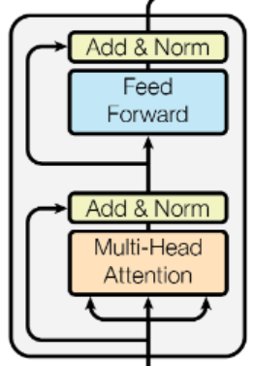
Our Hopfield-Based Model
Main difference – no convolutions
Resembles a Transformer’s Encoder block:
Flattened input layer
Multi-headed Hopfield layer with batch normalization
Dense layer with batch normalization and ReLU activation
Dense output layer

Slide 9
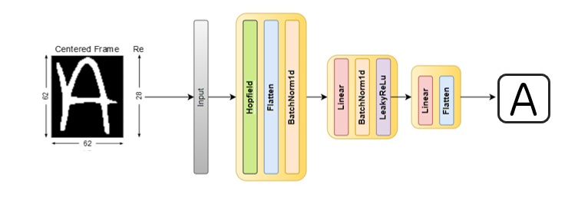
Final Architecture

Slide 10
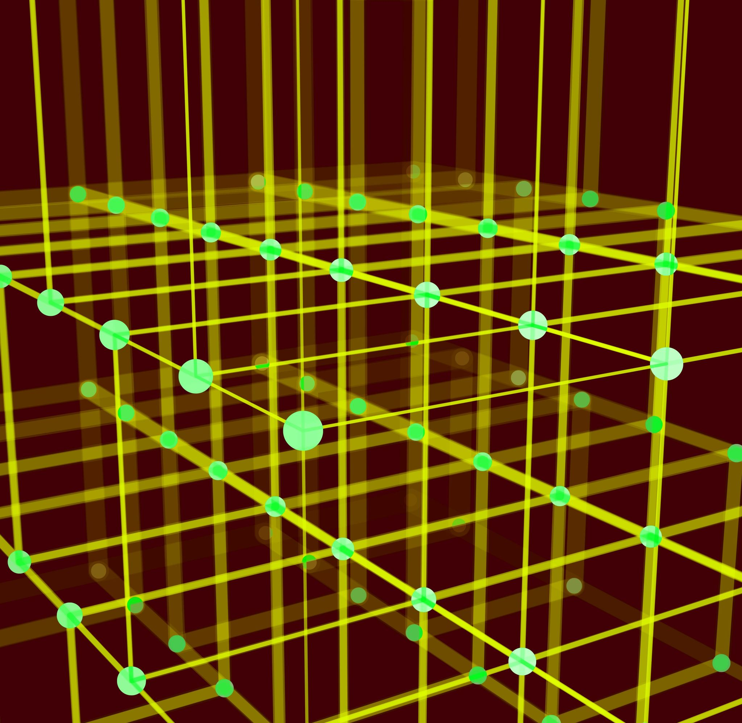
Implementation in Pytorch

Slide 11
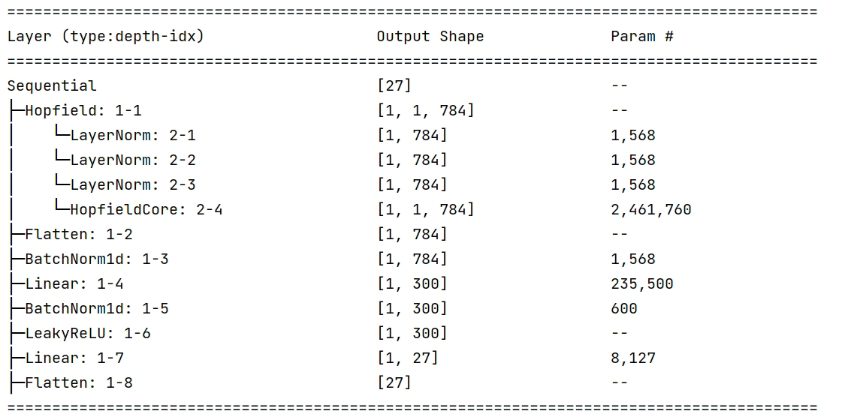

Slide 12
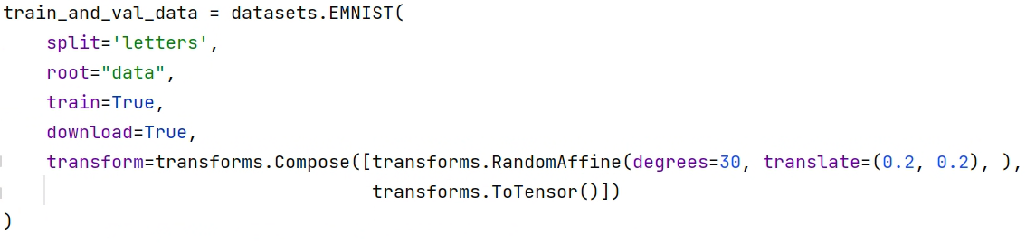
Image Augmentation
...

Slide 13
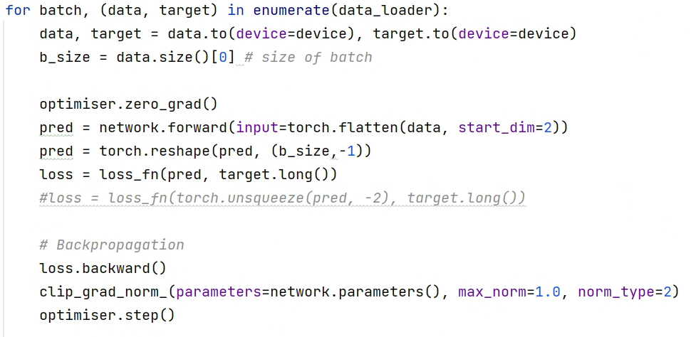
Fitting the model in Pytorch

Slide 14

Integration of Hopfield Layer in Pytorch
The official implementation of Hopfield layers can be found on GitHub:
https://github.com/ml-jku/hopfield-layers
This implementation works with the Pytorch interface and can be set as a Pytorch Layer.

Slide 15
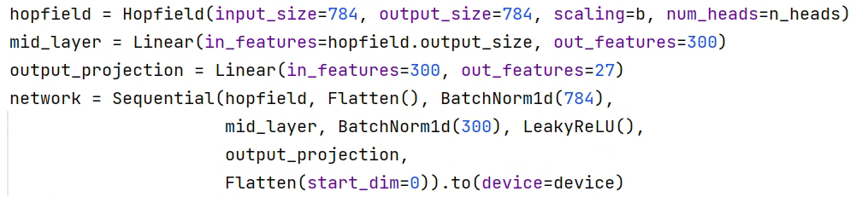
...

Slide 16
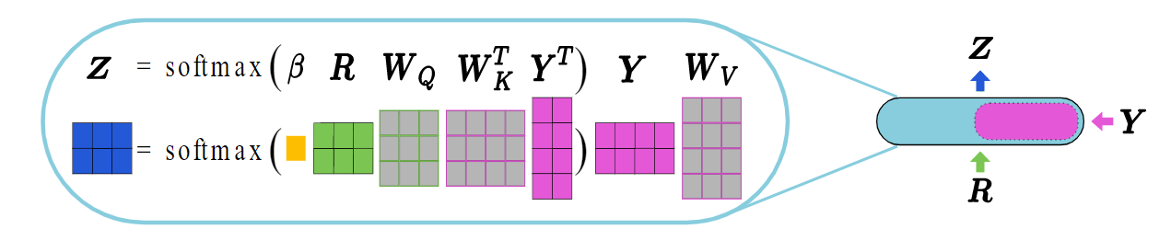
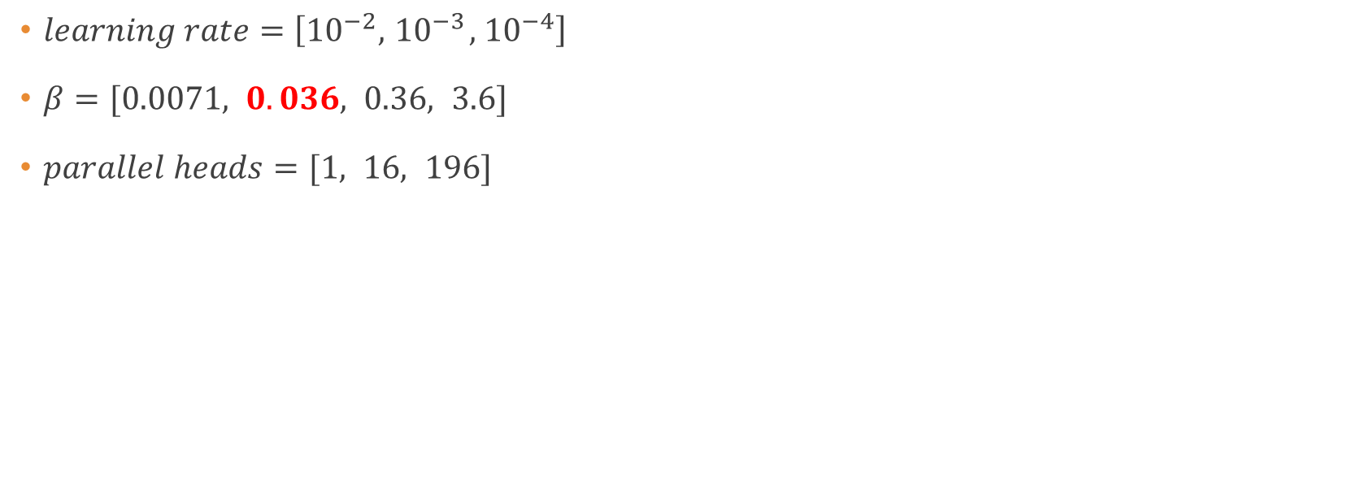
Model Optimization
$learning rate=\left[{10}^{−2}, { 10}^{−3}, { 10}^{−4}\right]$
$β=[0.0071, 0.036, 0.36, 3.6]$
$parallel heads=[1, 16, 196]$

Slide 17
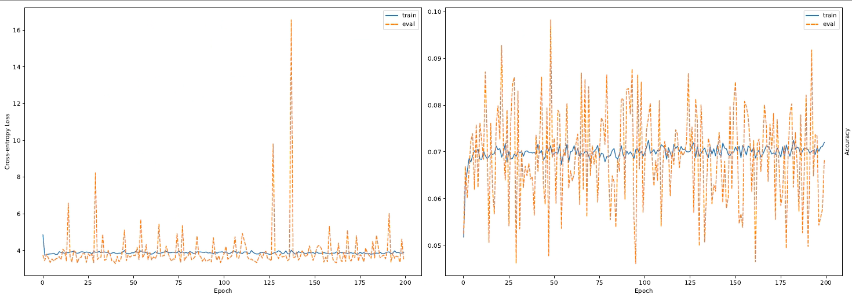
First Results
Aren’t we forgetting something??

Slide 18
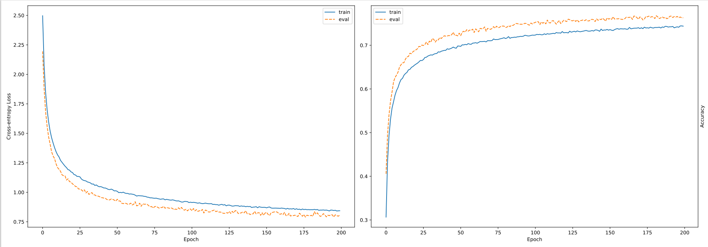
Results of Optimization 1

Slide 19
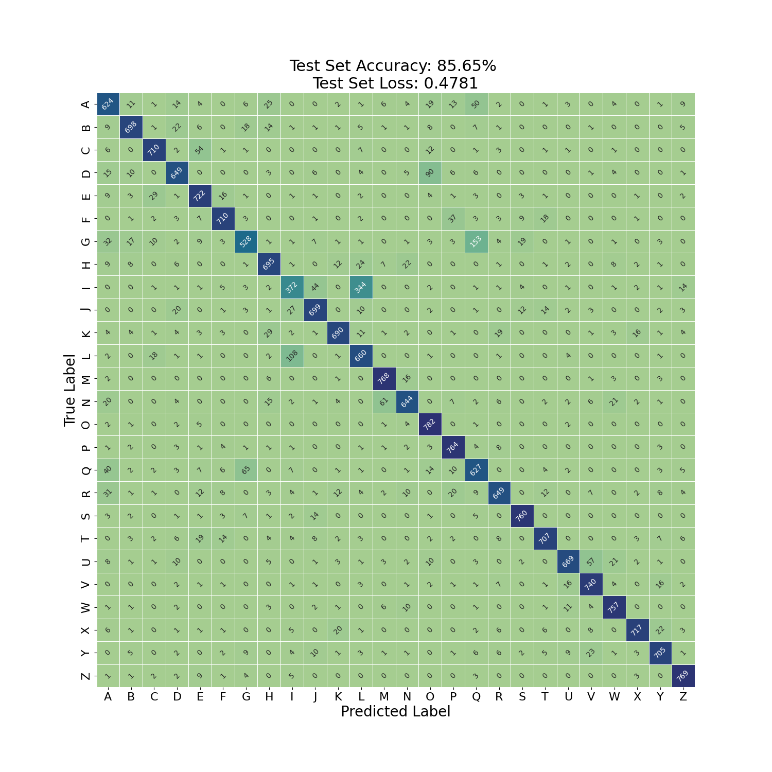

Confusion Matrix
$learning rate={10}^{−4}$
$β=3.6$
$parallel heads=1$

Slide 20
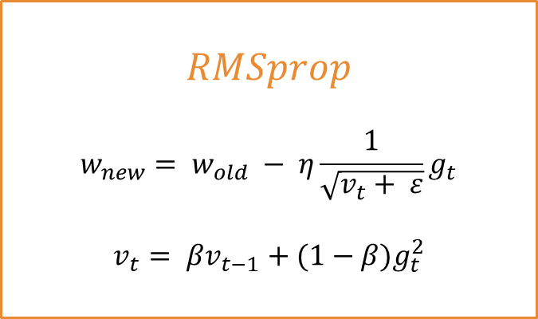
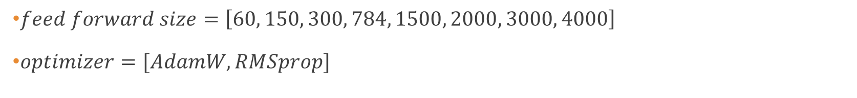
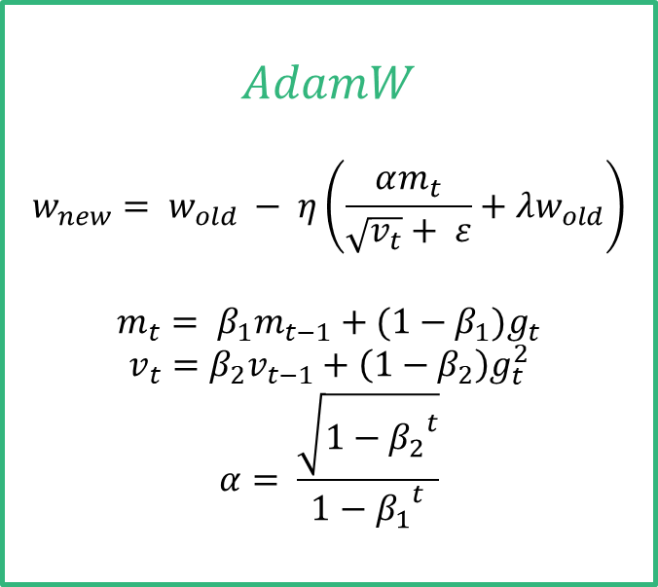
Optimizing Feed-Forward and Optimizer
$feed forward size=\left[60, 150, 300, 784, 1500, 2000, 3000, 4000\right]$
$optimizer=[AdamW, RMSprop]$
$$AdamW$$
$$w_{new}= w_{old} − η\left(\frac{αm_{t}}{\sqrt{v_{t}}+ ε}+{λw}_{old}\right)$$
$$m_{t}= β_{1}m_{t−1}+(1−β_{1})g_{t}$$
$$v_{t}=β_{2}v_{t−1}+\left(1−β_{2}\right)g_{t}^{2}$$
$$α= \frac{\sqrt{1−{β_{2}}^{t}}}{1−{β_{1}}^{t}}$$
$$RMSprop$$
$$w_{new}= w_{old} − η\frac{1}{\sqrt{v_{t}+ ε}}g_{t}$$
$$v_{t}= βv_{t−1}+(1−β)g_{t}^{2}$$

Slide 21
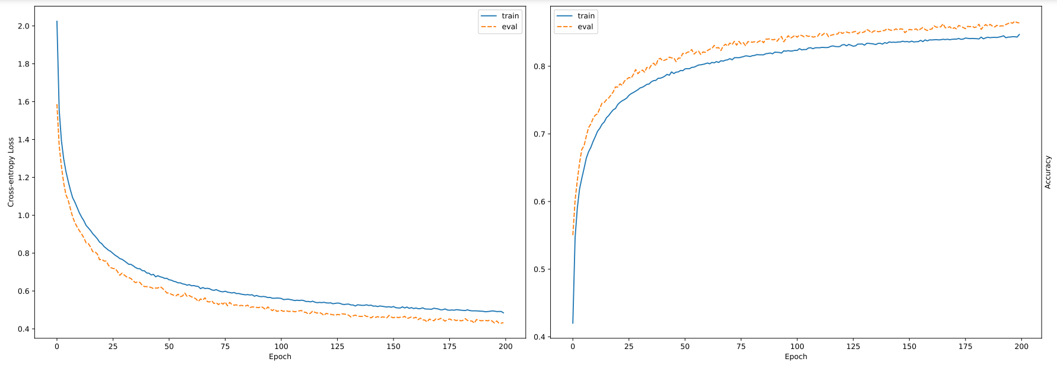
Results of Optimization 2

Slide 22
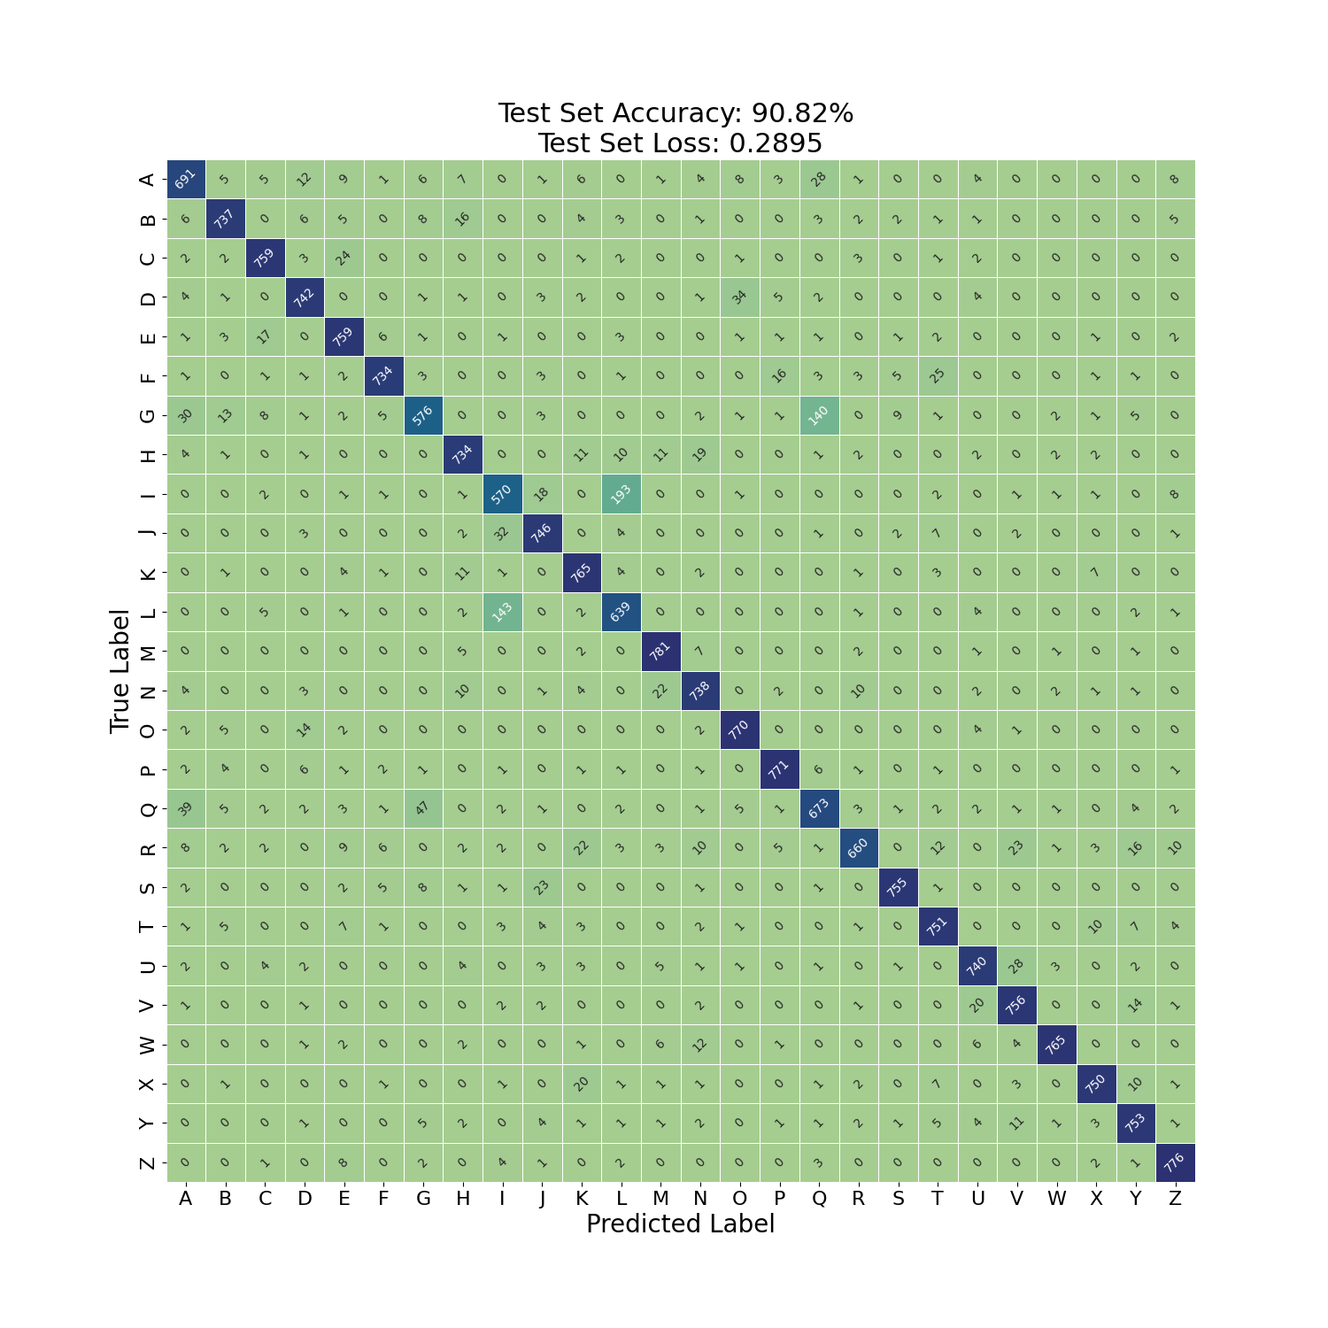

Confusion Matrix
$feed forward size=3000$
$optimiser=$rmsprop

Slide 23
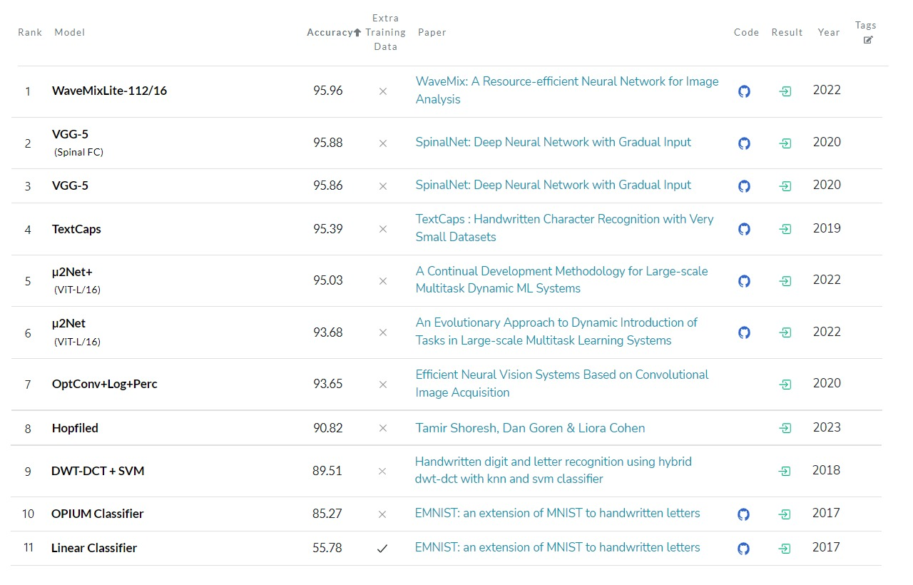

Slide 24
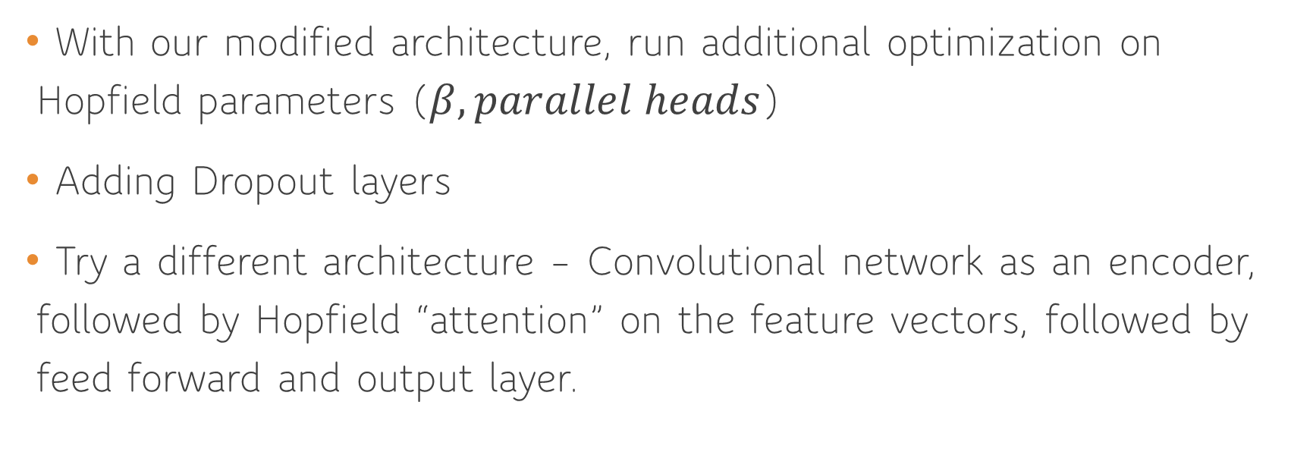
Future Work
With our modified architecture, run additional optimization on Hopfield parameters ($β, parallel heads$)
Adding Dropout layers
Try a different architecture – Convolutional network as an encoder, followed by Hopfield “attention” on the feature vectors, followed by feed forward and output layer.

Slide 25
Thank You!

